Slide 1
PRODUCT DEMO · MVP · FAKE DATA ONLY
1
Capture
Medicare Rx
Affordability Navigator
2
Checklist
3
Check
A Chrome extension that finds prescription payment help for Medicare patients — in five guided steps, right on top of the EHR.
4
Recommend
5
Share
Affordability navigation only — not medical advice. Preliminary screening; every result must be verified.
Notes:
OPENING (30s): Medicare patients walk away from prescriptions they could get help with — not because programs don't exist, but because nobody at the counter has time to check five programs with five rule books. This extension does that check in about a minute, on top of the EHR. Before we start: this is affordability navigation only. It never suggests changing a medication, and every result is a preliminary screen that gets verified with the actual program.

Slide 2


The problem at the pharmacy counter
$88.40
WHAT IT IS
A screening assistant for providers & pharmacy staff
Five guided steps: capture → check → share
per month, out of pocket, for one anticoagulant — our demo patient's reality.
Help exists — federal, state, charitable
Every program has its own rule book
Nobody has time to check them all
WHAT IT IS NOT
Not clinical decision support — never touches therapy
Not a final determination · not for real PHI yet
Notes:
Frame the pain: the $88.40 copay is the demo patient's real number on the next screen. Programs exist but checking five rule books at the counter never happens. Set guardrails early (right column): screening assistant, not clinical decision support; results preliminary; MVP uses fake data only. Saying this up front buys trust for the rest of the demo.

Slide 3
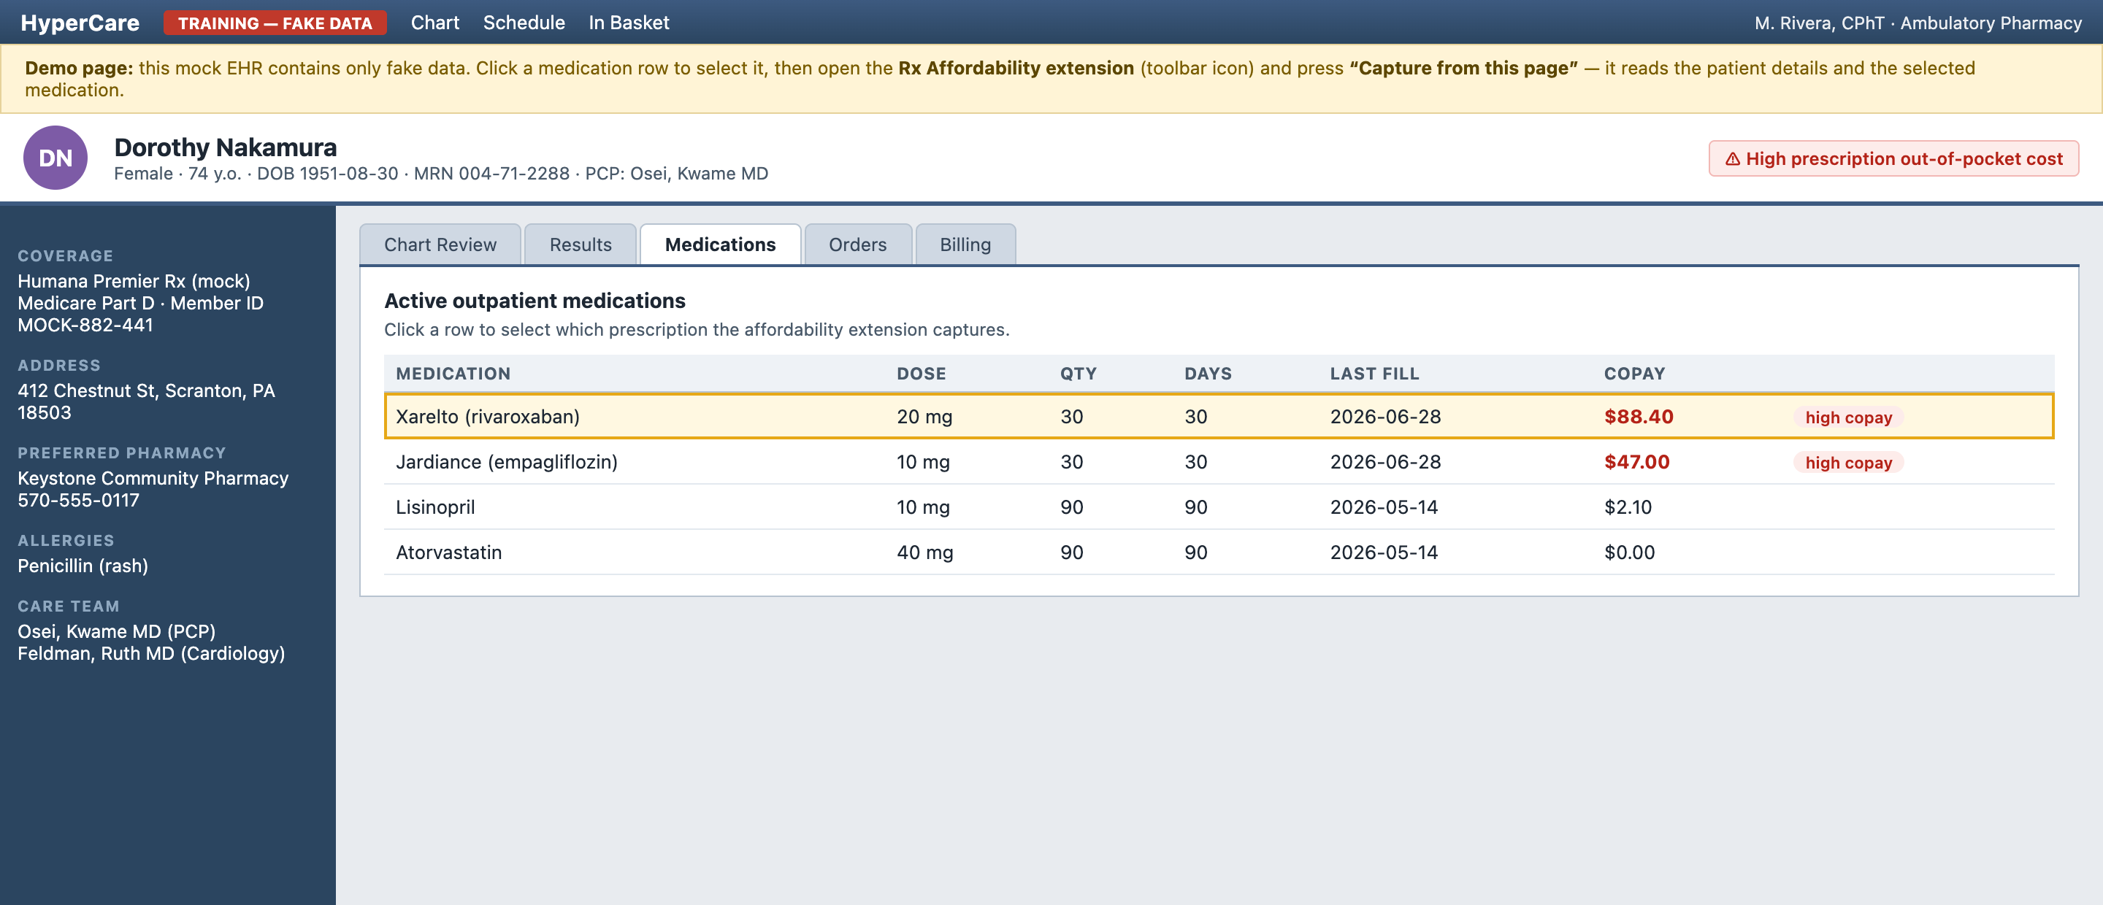
The stage: a fake EHR, a real workflow
DN
Dorothy Nakamura
74 · Scranton, PA · Part D
Xarelto 20 mg
$88.40
per fill — flagged high out-of-pocket
“HyperCare” is a training EHR built for this demo. Click any medication row to choose what gets captured. All data is fake.
Notes:
SCENE 1 (30s): 'Here's our pharmacy technician's view — a training EHR with fake data. Dorothy Nakamura, 74, Medicare Part D, Pennsylvania. Look at her med list: Xarelto, $88.40 out of pocket every month, flagged high out-of-pocket. Normally this is where someone shrugs: that's what your plan charges.' SETUP (do before presenting): 1) npm run dev 2) chrome://extensions → Load unpacked → dist/ 3) open localhost:5173/demo/sample-patient-page.html 4) backup: seeded case 'Margaret Chen' demos steps 2–5 if capture misbehaves.

Slide 4





Five steps, one straight line
The extension enforces this order — steps 3–5 unlock only after an evaluation exists.
1
2
3
4
5
→
→
→
→
Capture
Checklist
Check
Recommend
Share
Scrape the EHR page
Spot missing info
Run all program rules
Ranked plan + savings
Handout & referral notes
Every screen shows this stepper — numbered buttons say where they lead, completed steps stay clickable.
Notes:
This is the spine of the demo and the product. The UI itself is numbered exactly like this slide — a stepper on every screen, buttons labeled 'Continue to Step 3', completed steps turn green and stay clickable. Each following slide is one of these five circles.

Slide 5
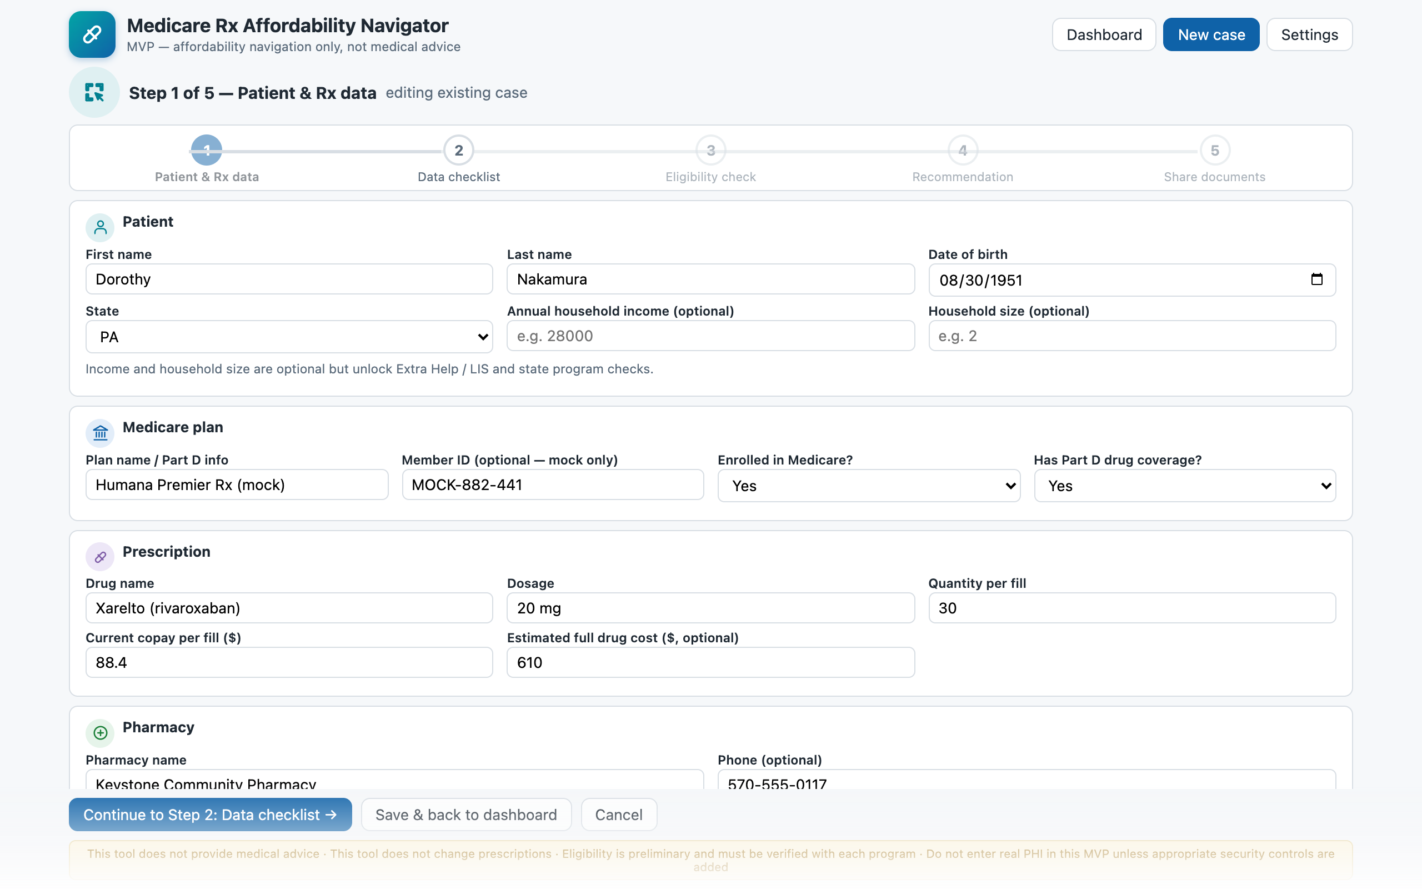
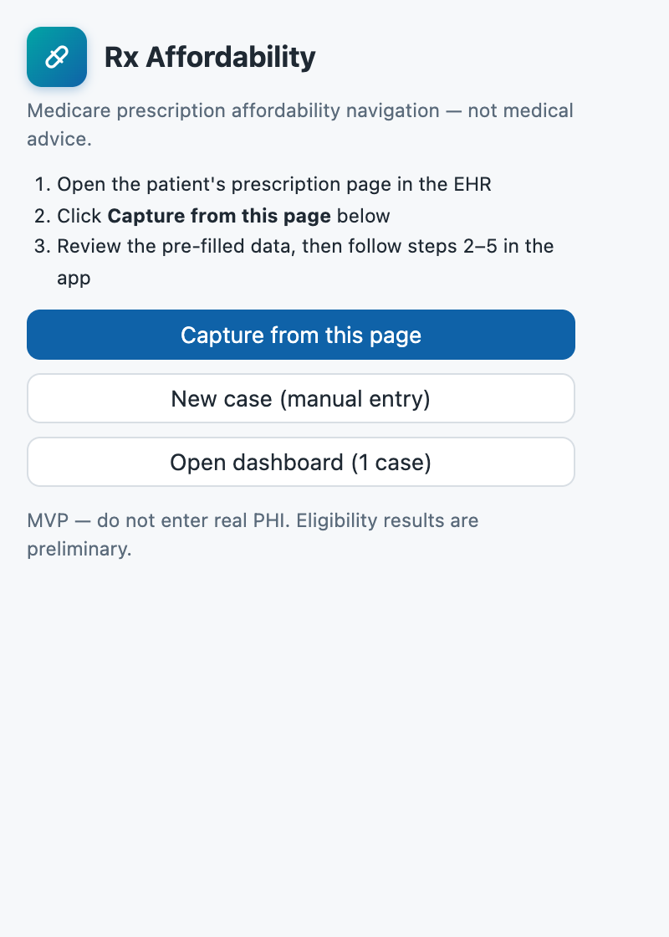
Step 1 of 5
1
2
3
4
5
Capture the data
WHAT YOU DO
1. Click the Xarelto row on the EHR page
2. Extension icon → “Capture from this page”
3. Review the pre-filled form — leave income empty
“Nine fields, zero retyping — and nothing leaves the browser.”
9 fields captured in one click — patient, DOB, state, plan, drug, dose, quantity, copay, pharmacy
Notes:
STEP 1 (45s): Click the Xarelto row (highlights amber), open the extension, read the popup's numbered instructions aloud, hit Capture. The intake form opens pre-filled. Say: 'The extension reads the page — patient, plan, the selected drug, the copay, her pharmacy — and drops it into an editable form. Note the banner telling me to review it. Nothing has left the browser.' While scrolling: income and household size are empty — the EHR doesn't know them. Leave them empty deliberately and click Continue to Step 2.

Slide 6
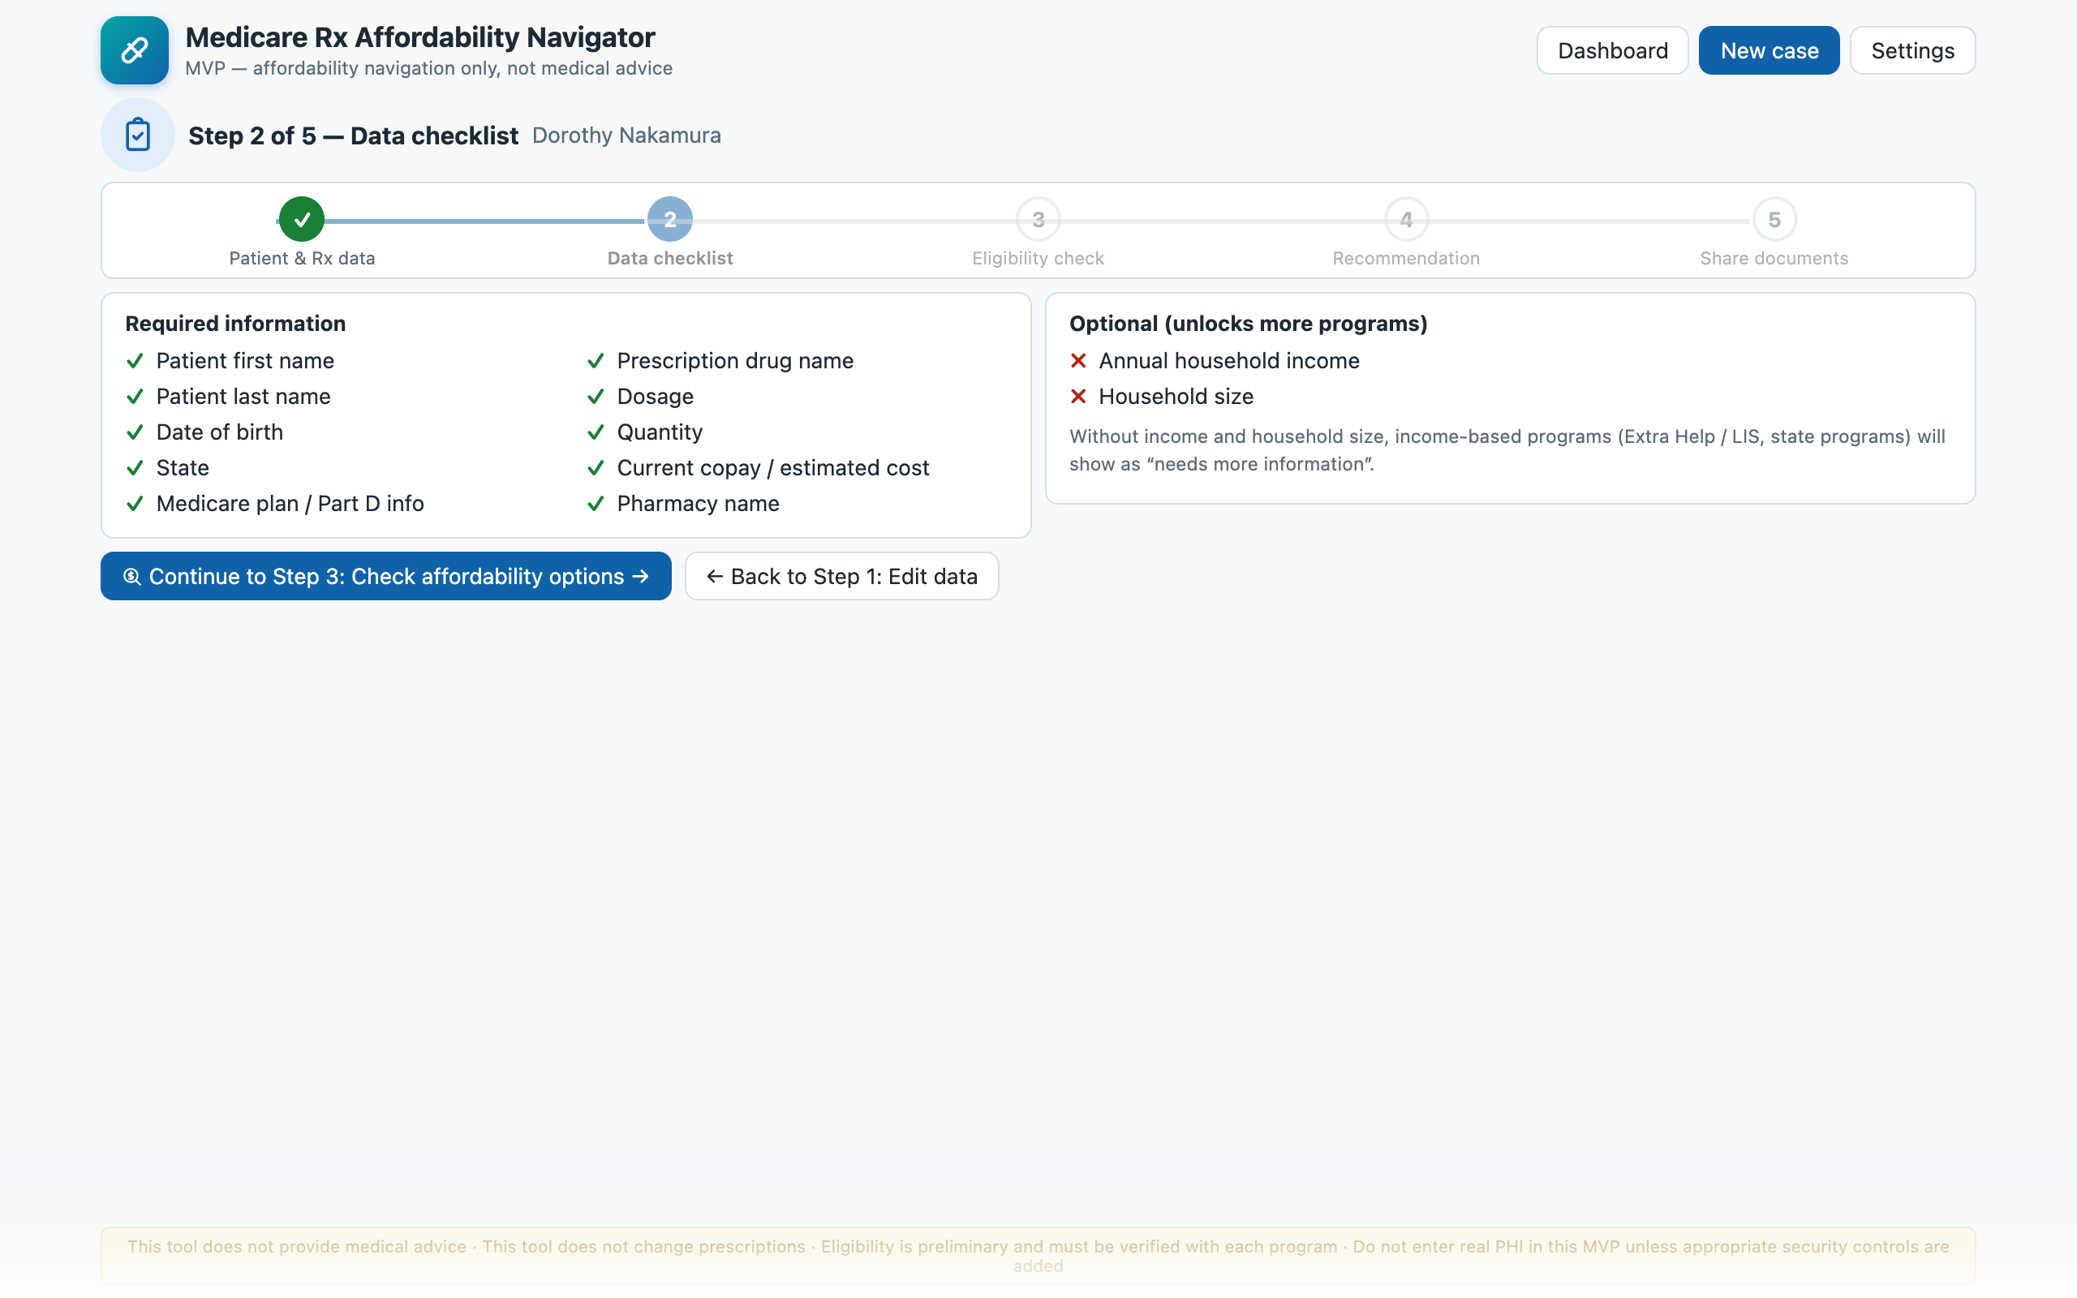
Step 2 of 5
✓
2
3
4
5
Data checklist
WHAT YOU DO
1. Show the required list — every row green
2. Point at the two red optional rows
3. Continue without income — on purpose
“The tool says what it doesn't know instead of guessing.”
The checklist gates the flow — the Check button stays disabled until required data is complete
Notes:
STEP 2 (30s): 'What do we actually know? Everything required is green. But income and household size are optional and missing — the tool tells me income-based programs can't be determined without them. I could stop and ask Dorothy, but let's run with what we have, because that's what real intake looks like.' Click Continue to Step 3.

Slide 7
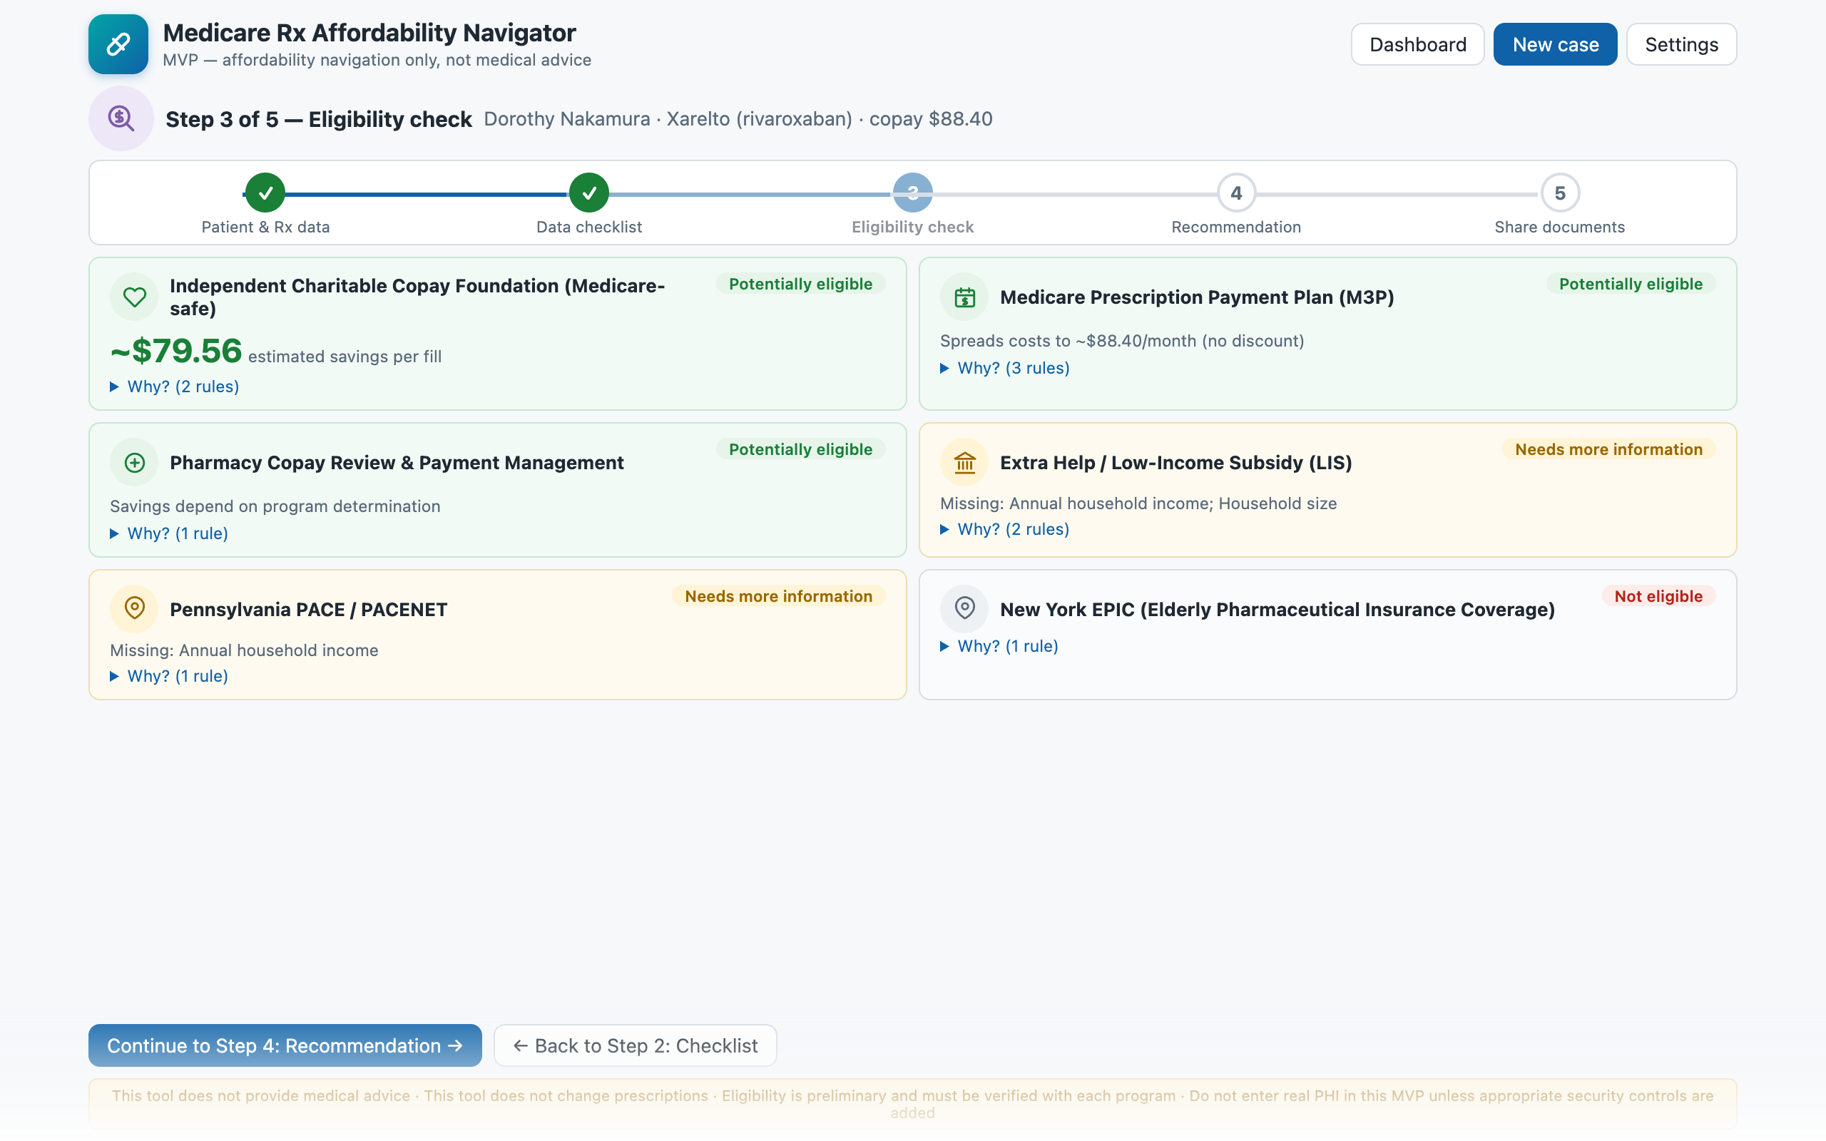
Step 3 of 5
✓
✓
3
4
5
Eligibility check — twice
WHAT YOU DO
1. Scroll ranked results — read one “why” line aloud
2. Extra Help & PACE say “needs more info” — not “no”
3. THE UNLOCK: add income $22k in Step 1, re-run — two programs flip to eligible
“Only Medicare-safe options — manufacturer copay cards are illegal here.”
First pass: 3 eligible, 2 need info → after one income question: 5 potentially eligible options
Notes:
STEP 3 (60s + 45s unlock): Scroll results. 'Top: an independent charitable copay foundation, roughly $79 per fill. Note it says INDEPENDENT — manufacturer copay cards are illegal for Medicare patients, so only Medicare-safe options are surfaced. M3P is eligible too: no discount, but monthly payments. Extra Help and PACE say NEEDS MORE INFORMATION — not no. The tool won't guess about income it doesn't have. Every card shows which rules passed and failed.' THE UNLOCK: click step 1 in the stepper, add income 22,000 and household 1 ('about 140% of the federal poverty level'), re-run. 'Extra Help flips to potentially eligible — the big one, it's federal and also cuts her premium. PACE flips too. Two more doors, one question.'

Slide 8
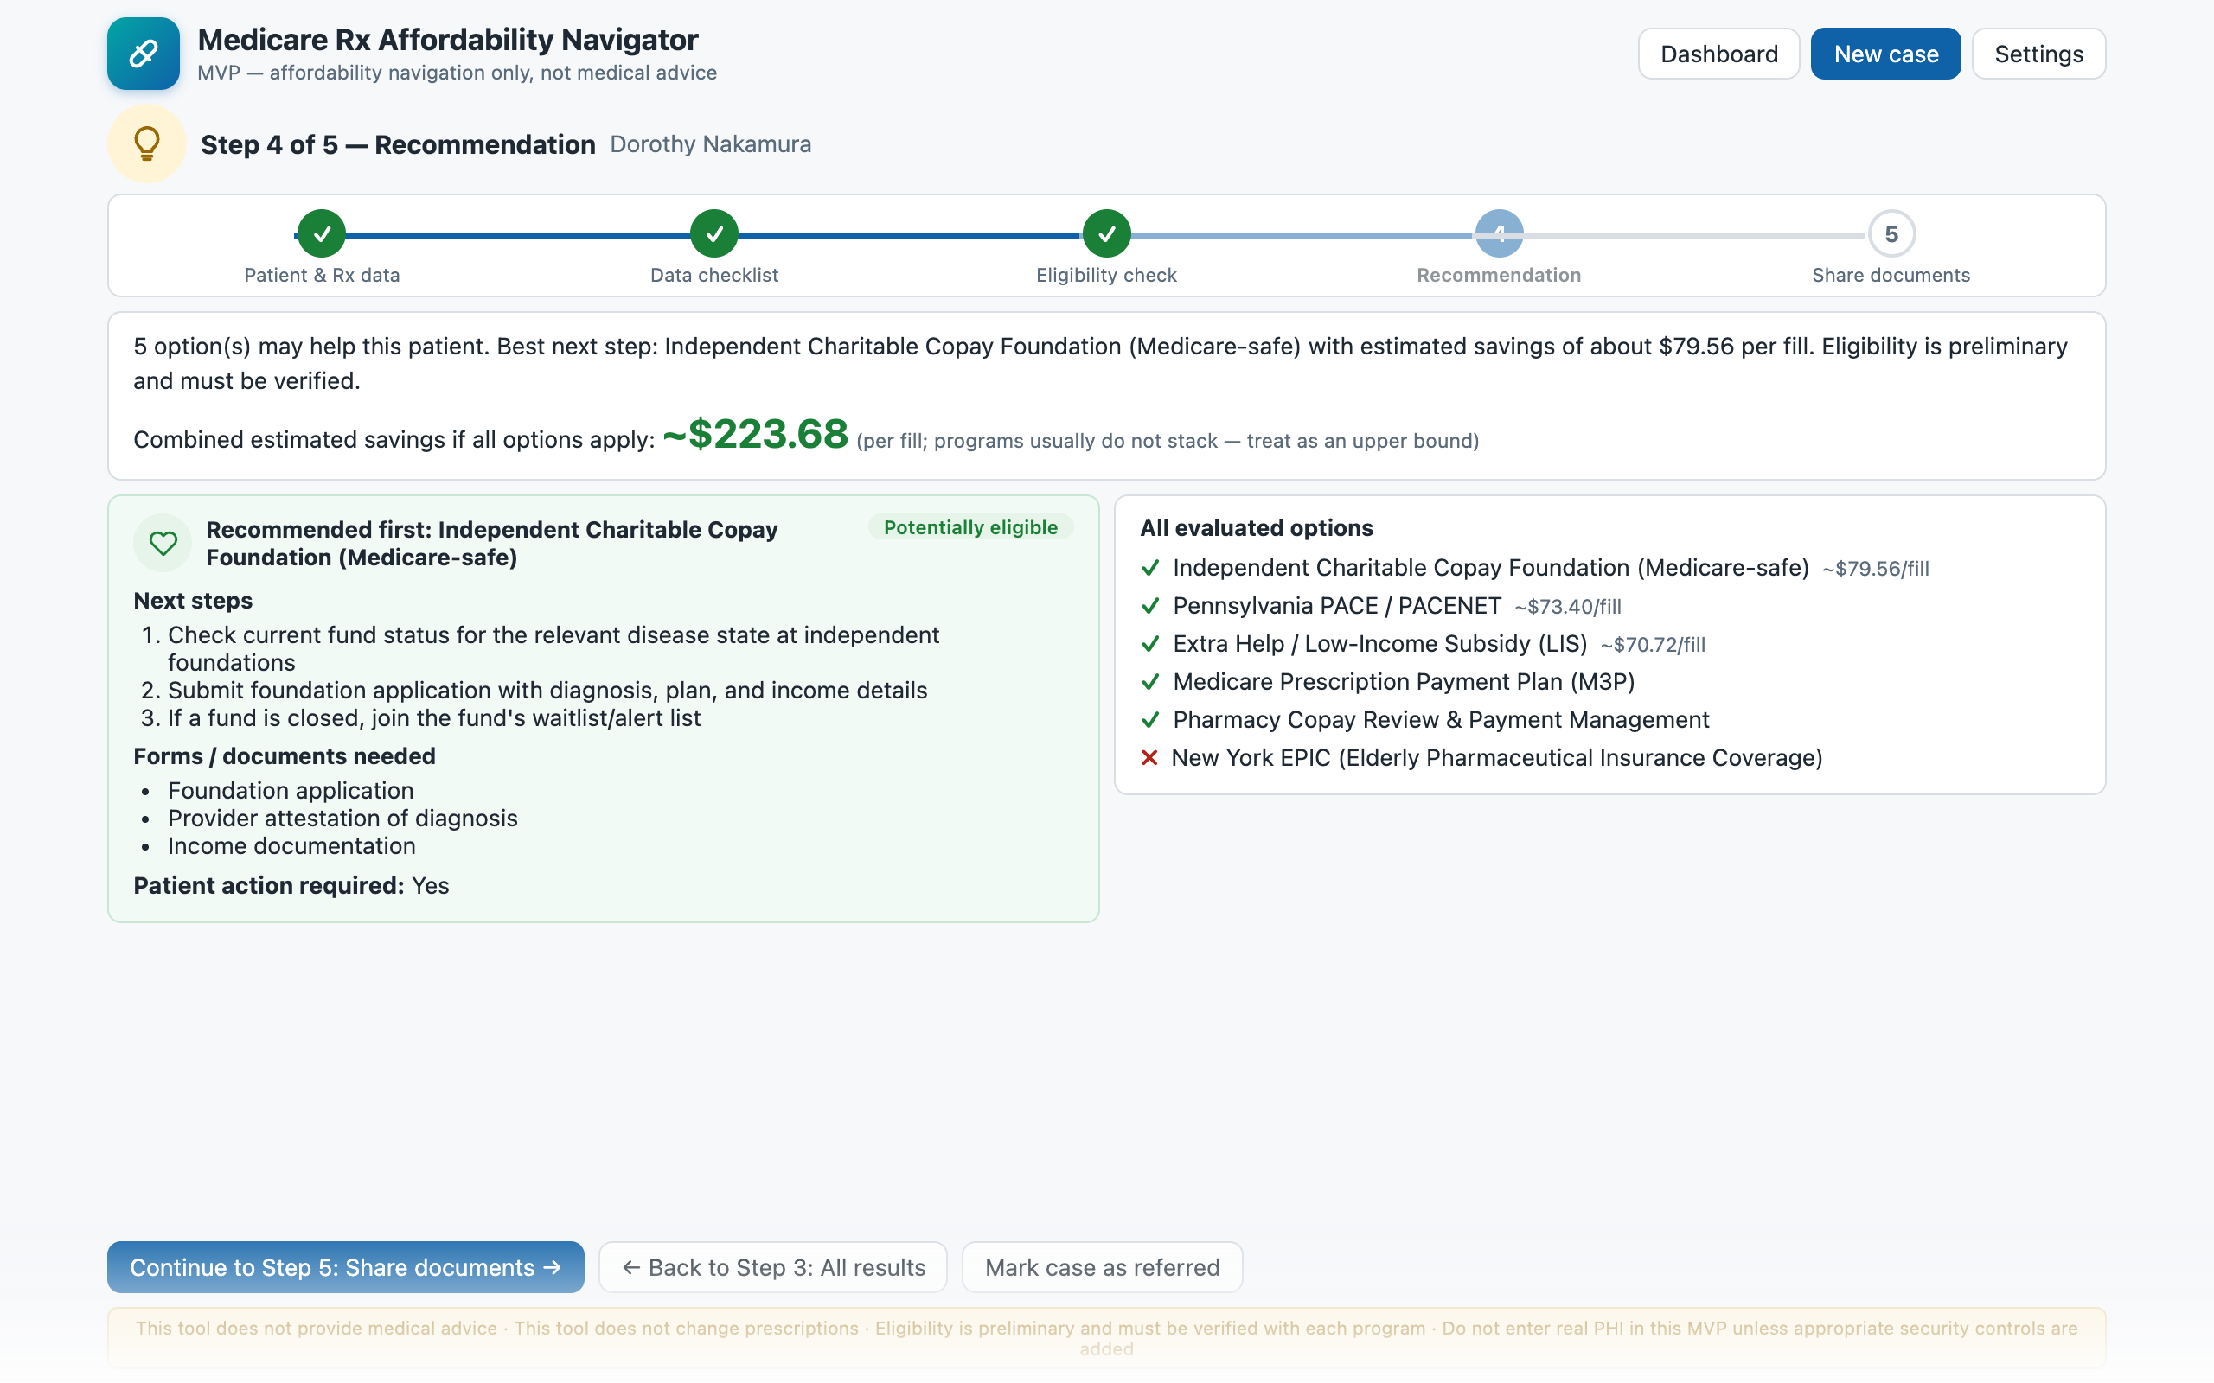
Step 4 of 5
✓
✓
✓
4
5
Recommendation
WHAT YOU DO
1. Walk the top option's numbered next steps
2. Point at forms needed + “patient action required”
3. Combined savings is labeled an upper bound
“Step four turns results into a plan.”
From an $88.40 copay to a ranked action plan — top option saves ≈ $79 per fill, pending verification
Notes:
STEP 4 (30s): 'The recommendation turns results into a plan: best option first, estimated savings, the exact next steps, which forms Dorothy needs, and whether she herself has to act. The combined ceiling is labeled as an upper bound because programs generally don't stack.' Click Continue to Step 5.

Slide 9
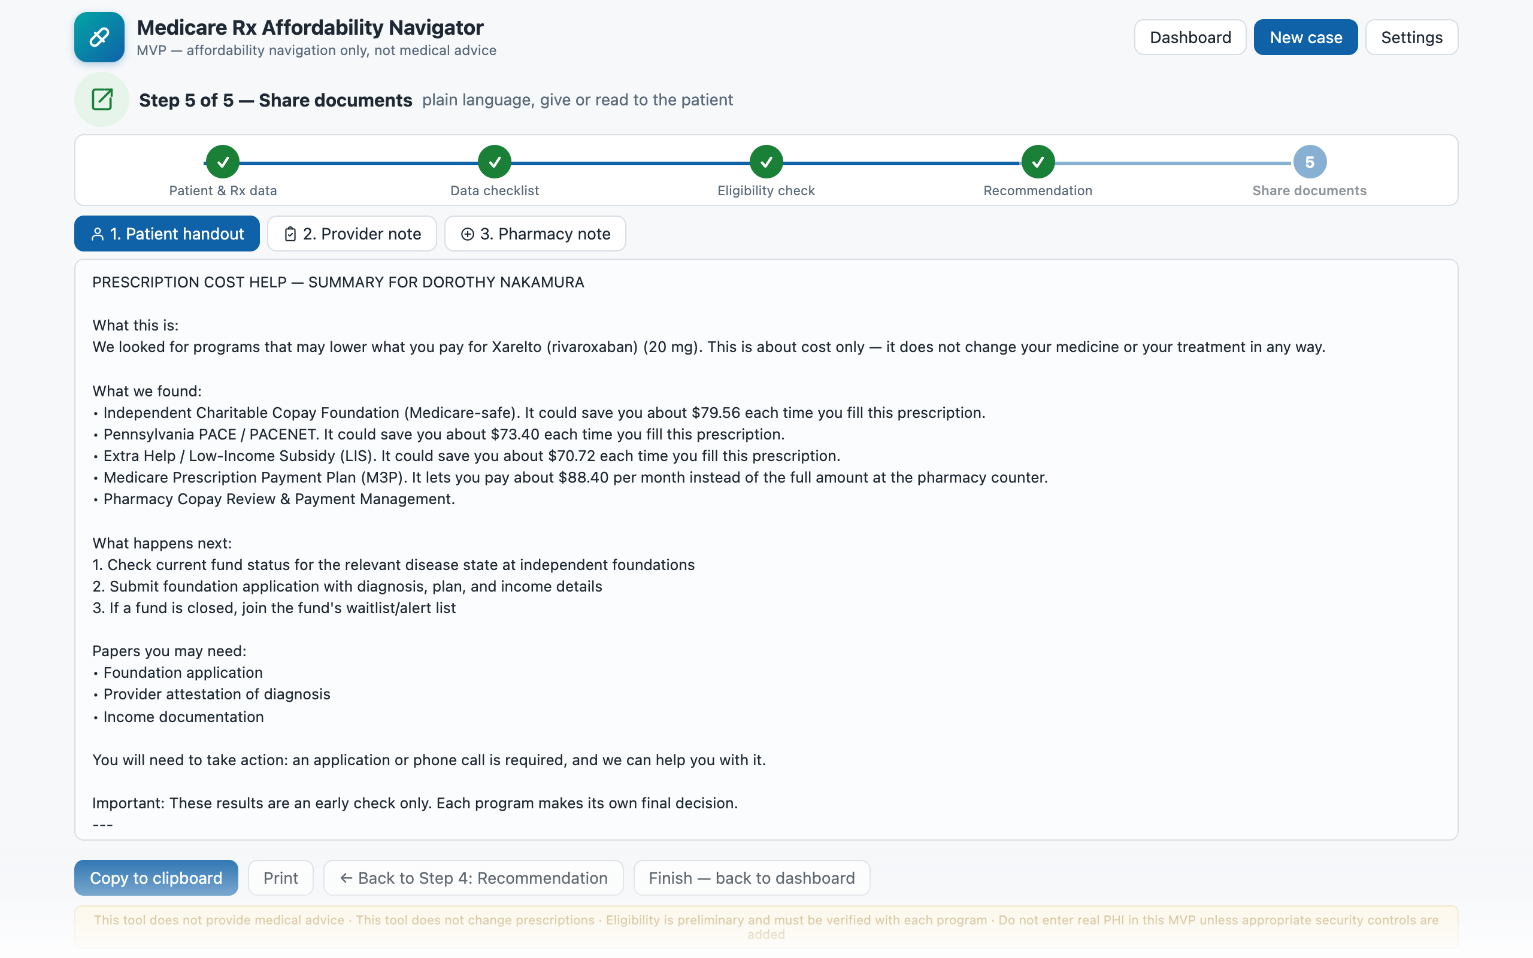
Step 5 of 5
✓
✓
✓
✓
5
Share documents
WHAT YOU DO
1. Flip the tabs: patient / provider / pharmacy
2. Copy one document to the clipboard
3. Back to dashboard — the case is saved
“The pharmacy note says it outright: dispense as written.”
Three generated documents, one case record saved locally — ready for follow-up review
Notes:
STEP 5 (45s): Flip the three tabs. 'A plain-language handout for Dorothy — what we found, what she needs to bring, what happens next. A provider note for the chart. A pharmacy note that explicitly says dispense as written, no medication change requested. Copy, print, done. The case is saved locally for follow-up.'

Slide 10



Under the hood — 60 seconds of architecture
→
→
→
Content script
React UI
Rules engine
Local storage
Reads the page on demand — never passively
Popup + 5-step app, Manifest V3
Pure TypeScript · 20 unit tests
No backend — chrome.storage only
Rules are configuration, not code
Every program is a JSON object — conditions, savings model, forms, next steps. Adding your state's program is a config change in Settings, not a release.
Notes:
For technical audiences (60s): four layers, cleanly separated. The content script only reads a page when the user clicks Capture — no passive collection. The rules engine is pure TypeScript with 20 unit tests and no UI imports, so it could run server-side unchanged. Punchline: programs are JSON config — show the Settings screen's rule editor if asked. Skip this slide for non-technical audiences.

Slide 11

The guardrails are the product
Four disclaimers appear on every screen and inside every generated document:
No medical advice
No prescription changes
Navigates payment, never therapy
Pharmacy notes say: dispense as written
Preliminary only
No real PHI in the MVP
Verify with the program before promising
Fake data until security controls land
Notes:
Land this slide slowly — it's what lets a healthcare audience relax. The four disclaimers aren't fine print; they're rendered on every screen and baked into every generated document. If asked why no manufacturer copay cards: federal anti-kickback rules prohibit them for Medicare patients; the tool only surfaces independent charitable foundations, and labels that reasoning right in the results.

Slide 12
From a shrug to a plan, in about a minute
1–2
Capture from the EHR, verify what's known
3
Every program's rules, one click, reasons shown
4–5
Ranked plan + three ready-to-share documents
TO MAKE IT REAL
Security & HIPAA controls before any real PHI
Maintained thresholds (FPL, LIS, all-state SPAPs) with yearly updates
SMART on FHIR instead of page scraping
Questions?
Notes:
CLOSE (30s): 'Recap — from an $88 shrug at the counter to a ranked, explainable action plan in about a minute. The rules are plain JSON: adding your state is a config change, not a code change. What it's not: not medical advice, never touches the prescription, preliminary until verified, and fake data only until real security controls exist. Questions?' Q&A cheat sheet lives in demo/DEMO_SCRIPT.md.

